Slide 1
Banking data
Data analysis assignment

Slide 2
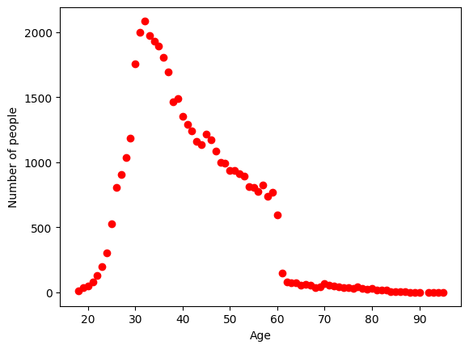
Distribution of age among the clients
From age distribution I got:
Mean of age =40.9381855980184
Mode of age= 32(more frequent)
Median of age =39
From statistics we call this type of distribution as positive skewed distribution.

Slide 3
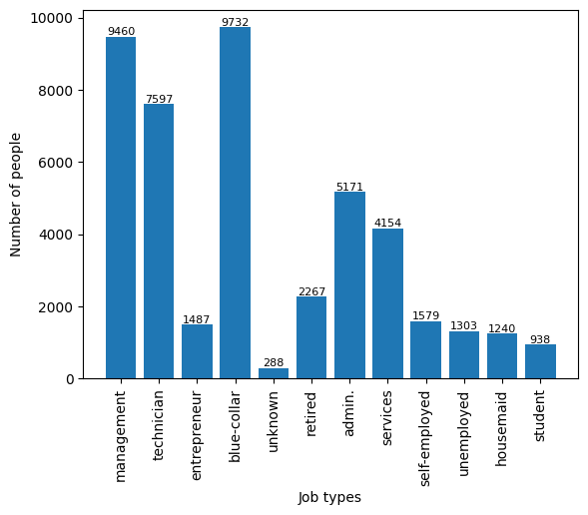
Variation of job types among clients
In the dataset maximum people are doing blue-collar job followed by management and so on…

Slide 4
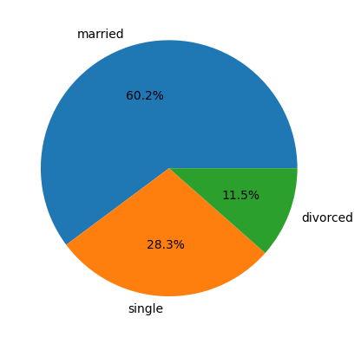
Marital status distribution of the clients
As shown in the pie chat, in this marketing champaign 60.2% clients are married,20.3% are unmarried and 11.5% are divorced….

Slide 5
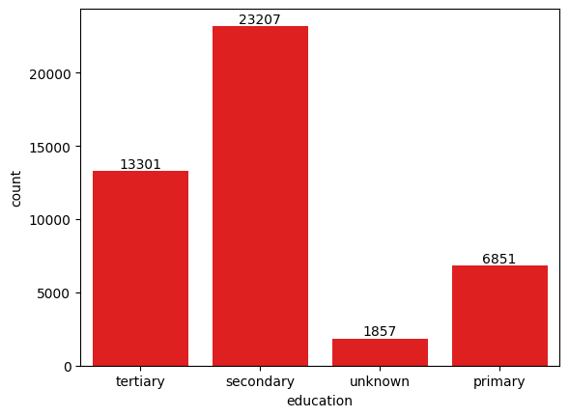
Level of education among the clients
In this column, 3 nan values was there and after fill the nan values with most frequently occurred (mode) row value, the analysis was done…
More no of clients completed secondary level education followed by tertiary and primary. Also 1857 clients has no record about education.

Slide 6
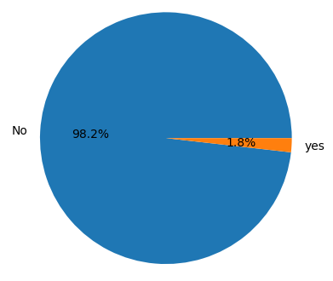
Proportion of clients have credit in default
Only 1.8% of the total clints has credit in default compared to 98.2% clints has no credits in default..

Slide 7
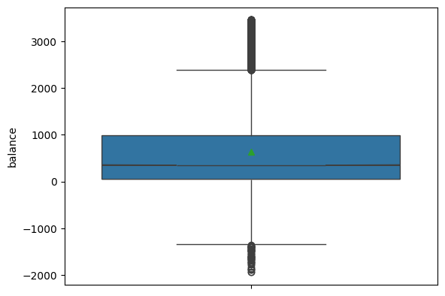
Distribution of average yearly balance among the clients
After removing the outliers using Interquartile range(IQR) method I have plotted the graph and it is showing the distribution of average yearly balance among the clients.. As the black line inside the box is below the centre of the box, The distribution is called +ve skewness distribution..

Slide 8
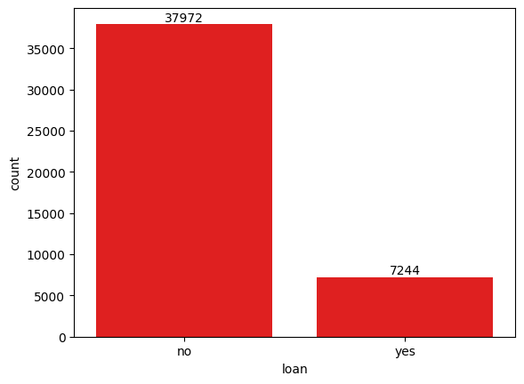
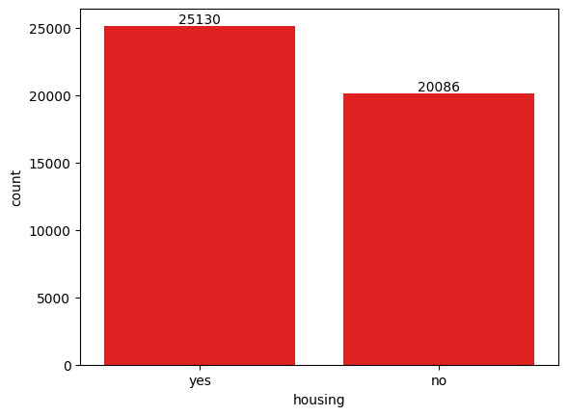
Clients have housing loans and personal loans
This 2 graphs are clearly showing distribution of no of clients having house loan and personal loan…

Slide 9
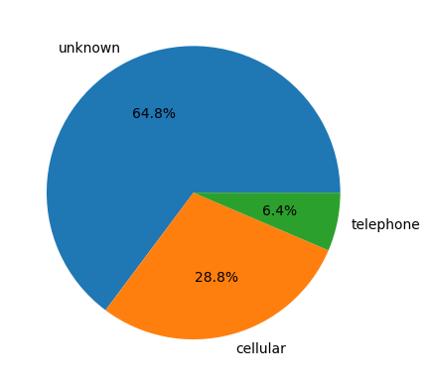
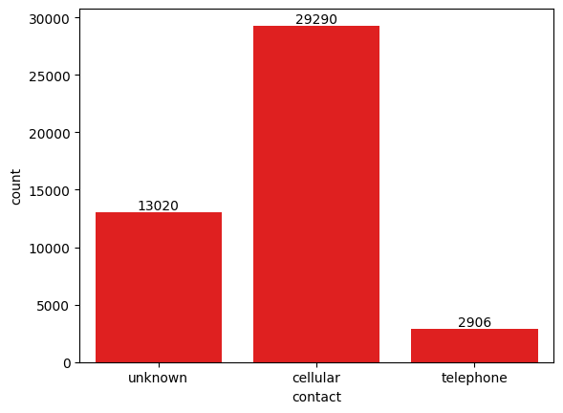
Communication types used for contacting clients during the campaign
Just 2 different type of representations of how the clients are contacted during the campaign..

Slide 10
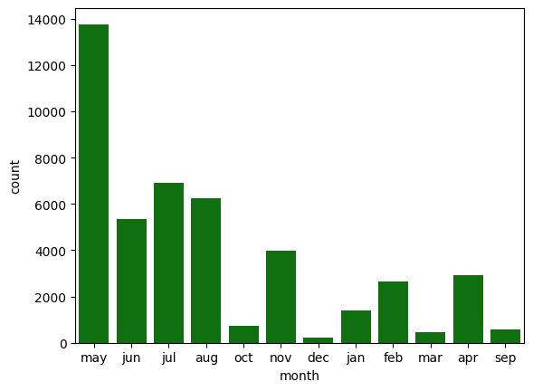
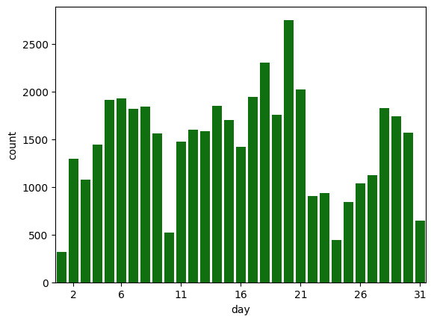
Distribution of the last contact day of the month and month of the year

Slide 11
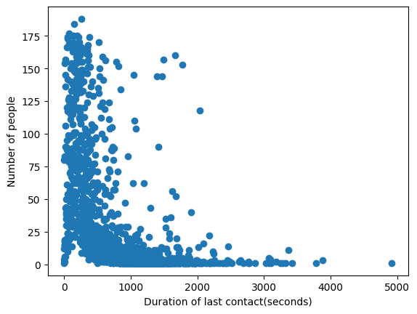
Duration of the last contact

Slide 12
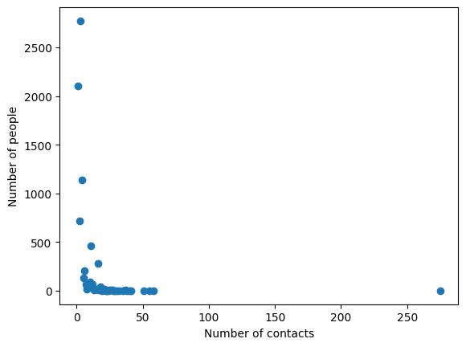
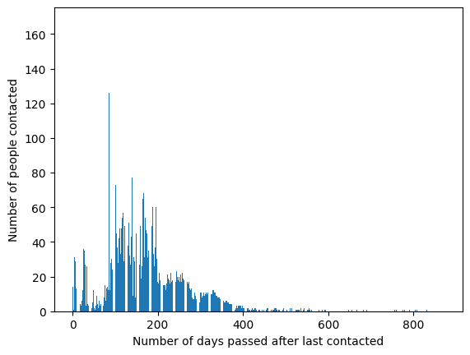
How many contacts were performed during the campaign for each client
Distribution of the number of days passed since the client was last contacted from a previous campaign

Slide 13
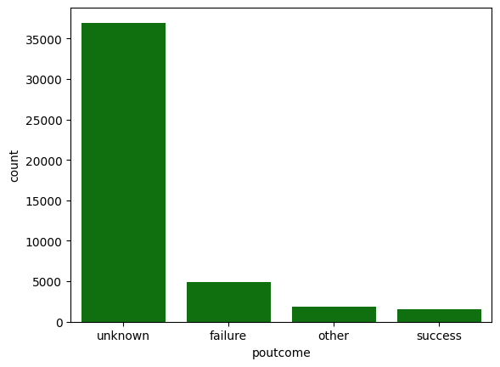
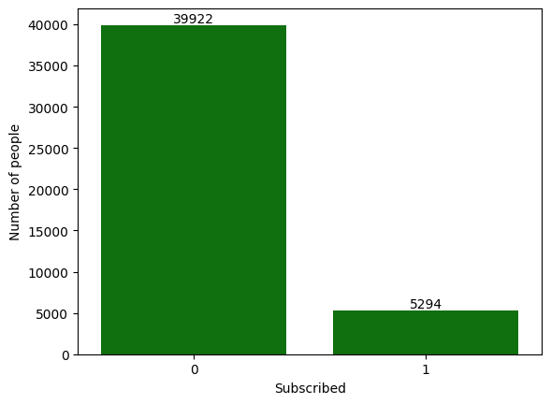
Outcomes of the previous marketing campaigns
No of clients who subscribed to a term deposit vs. Those who did not

Slide 14
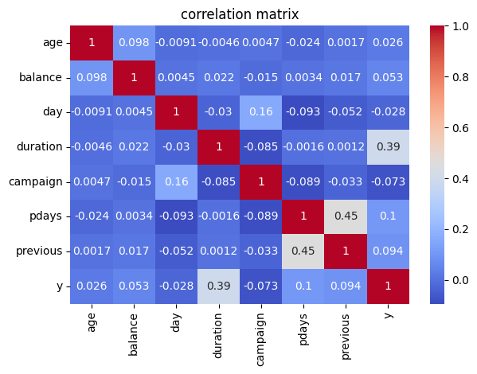
Correlations between different attributes and the likelihood of subscribing to a term deposit
After changing the Y categorical column into numeric column using label encoder class of Sklearn library the corelation is taken between all numeric columns… it can be observed that the likelihood of subscribing the term deposited has highest dependence on duration of call during the campaign.

